Slide 1
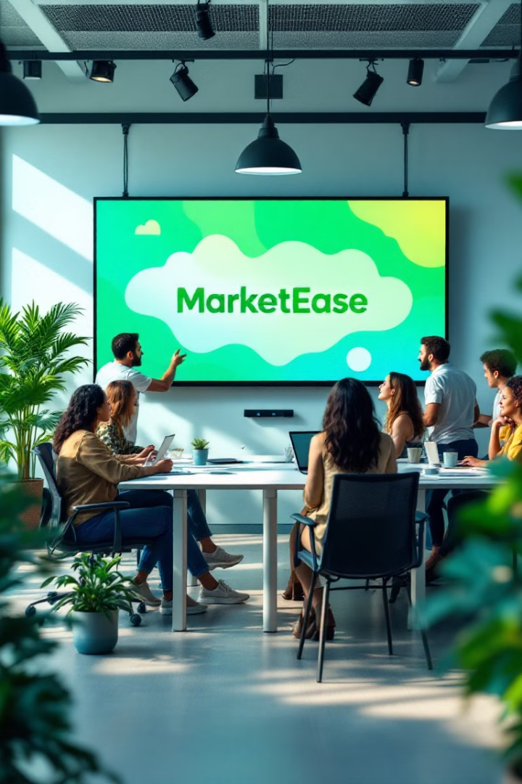
Project Name:
MarketEase – AI-Powered Marketing Partner
Focus on your Business, let AI handle your marketing.

Slide 2
The Problem Statement
The Challenge for Business Owners
Should they focus on product development or spend time on marketing?
Hiring a Digital Marketing Agency → Costs ₹40K-₹50K per month
DIY(Do it yourself)Marketing → Time-consuming, requires expertise
Lack of Automation → Manual work, inefficient processes
Conclusion: Businesses need a cost-effective, automated, AI-driven marketing solution.

Slide 3
Our Solution – MarketEase
💡 An AI-powered platform that provides all marketing services done by agencies, plus additional automation.
✅ Reduces effort – Automates marketing, meetings, and social media.
✅ Saves time – AI manages everything, freeing up business owners.
✅ Cuts costs – Eliminates the need for expensive agencies.
MarketEase = AI-Powered Marketing + Smart Task Automation

Slide 4
Key Features & Functionality
1. Smart Meeting & Task Scheduling
2. AI-Generated Content & Auto-Posting
📩 AI scans emails → detects important meetings → one-click accept/reschedule → automatic response sent.
📝 Users line up post titles → AI creates text & images → Auto-posts to Instagram, Facebook, Blogs, & Newsletters
3. Automated Social Media Marketing
4. Chat & Voice-Enabled Task Execution
📊 Runs targeted paid ads → AI analyzes & optimizes campaigns → Generates high-converting leads.
🎙 Users can type or say:
“Reschedule my meeting with Mr. Sharma”
“Upload a post on ‘Best Marketing Strategies’” 🚀 AI instantly completes the task!

Slide 5
Target Audience & Market Opportunity
Target Audience
Market Size
Small & Medium Businesses (SMBs)
Digital marketing industry worth $400B+ globally.
Startups & Entrepreneurs
70% of SMBs struggle with costly & time-consuming marketing.
Freelancers & Solopreneurs
Local Businesses & E-commerce Brands
AI-driven marketing is the future of business growth
MarketEase offers an affordable, user-friendly solution compared to enterprise-level platforms.

Slide 6
Architecture & Technology
📌 1: User Input & Integration
📌 2: AI Processing & Decision Making
Users connect their email, social media, and marketing accounts.
NLP-based AI scans emails for meetings.
AI generates & schedules content for social media.
AI extracts relevant tasks & meeting details.
AI analyzes ad campaigns & optimizes targeting.
📌 3: Task Execution & Automation
📌 4: Continuous Learning & Improvement
AI auto-sends emails for meetings.
AI analyzes engagement data to improve future campaigns.
AI creates & posts content on social platforms.
System learns user preferences for smarter automation.
AI runs ad campaigns & generates reports.
Technology Stack: Html / CSS/ Javascript (frontend),Python / Nodejs (backend), MySQL/MongoDB (database),NLP/TensorFlow (AI & Automation).

Slide 7
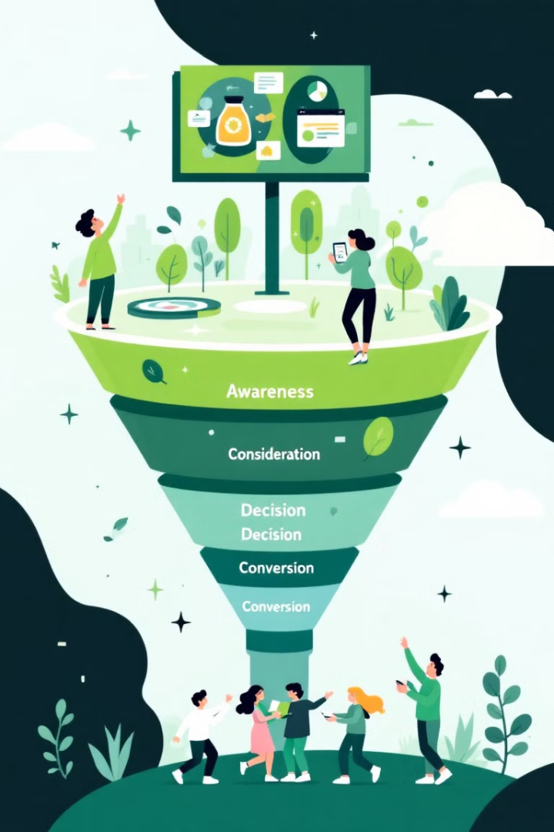



Marketing & Sales Strategy
Content Marketing & SEO
AI-generated blogs about digital marketing & automation.
SEO-optimized website to rank on Google for marketing keywords.
Freemium Model to Attract Users
Free basic plan (Limited AI-generated posts & scheduling).
Premium plans for full automation & paid ad integration.
Sales Strategy
Direct Outreach (B2B Sales)
Paid Advertising (Performance Marketing)

Slide 8
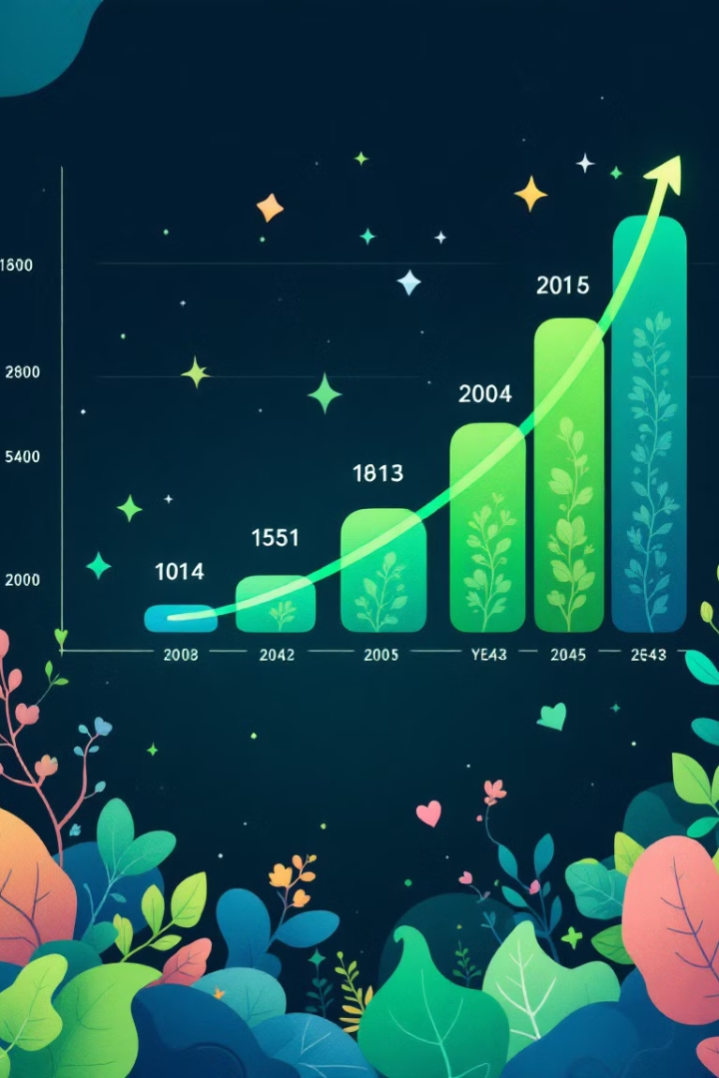
Financial Projections & Key Metrics
$500K
$2M
Year 1 Revenue
Year 3 Revenue
$5M
Year 5 Revenue
1 ️⃣ Subscription Plans (Monthly/Annual AI-powered marketing services) 2 ️⃣ Freemium Model (Basic features free, premium features paid) 3 ️⃣ Commission on Paid Ad Campaigns

Slide 9

Call to Action & Next Steps
1
Investment Opportunity
2
Partner with Us
MarketEase presents a compelling investment opportunity in a rapidly expanding market.
We seek strategic partners and investors who share our vision.

Slide 10

Thank You!
We appreciate your time and consideration. MarketEase is poised to revolutionize marketing for SMBs.

